Slide 1
Project - 1
Global Video Game Sales Analysis
Using Hive and HDFS
Prepared By :
VENKATA REDDY KOVVURI

Slide 2
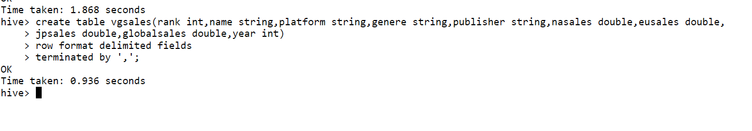
Query for Creating Hive table

Slide 3
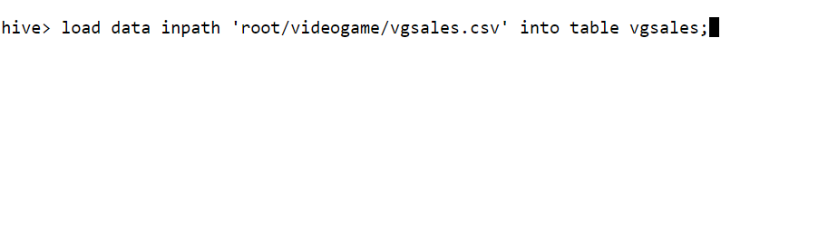
Query for Loading data into Hive table from HDFS

Slide 4
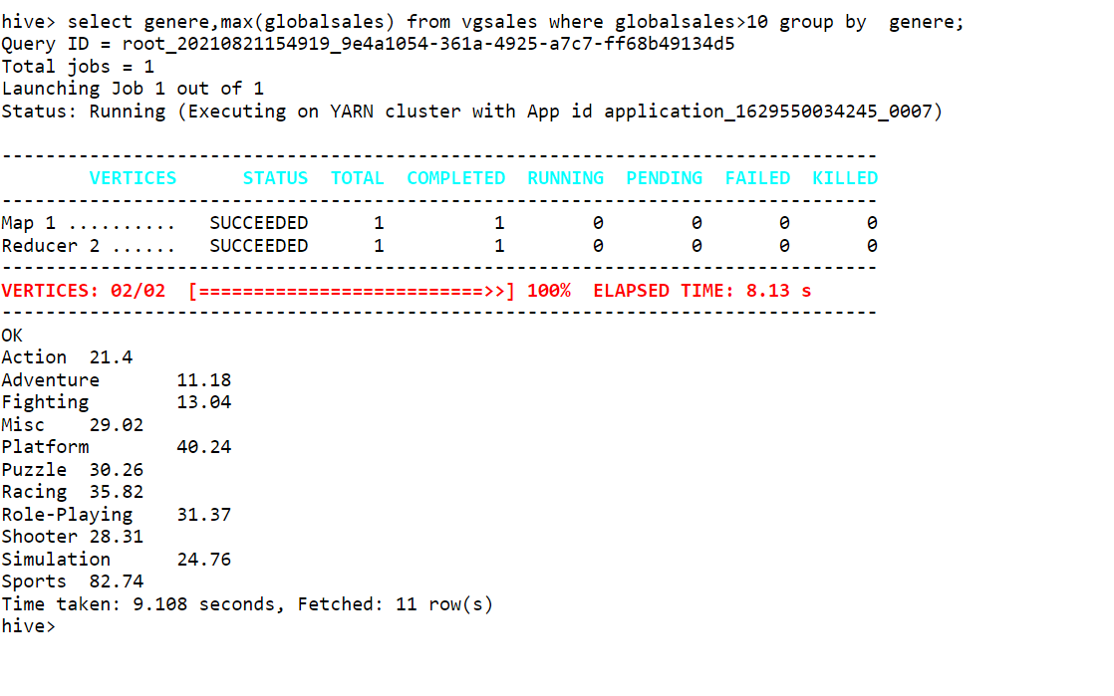
Query for obtaining genere and its maximum global sales which are above 10 scale and grouping them by genere

Slide 5
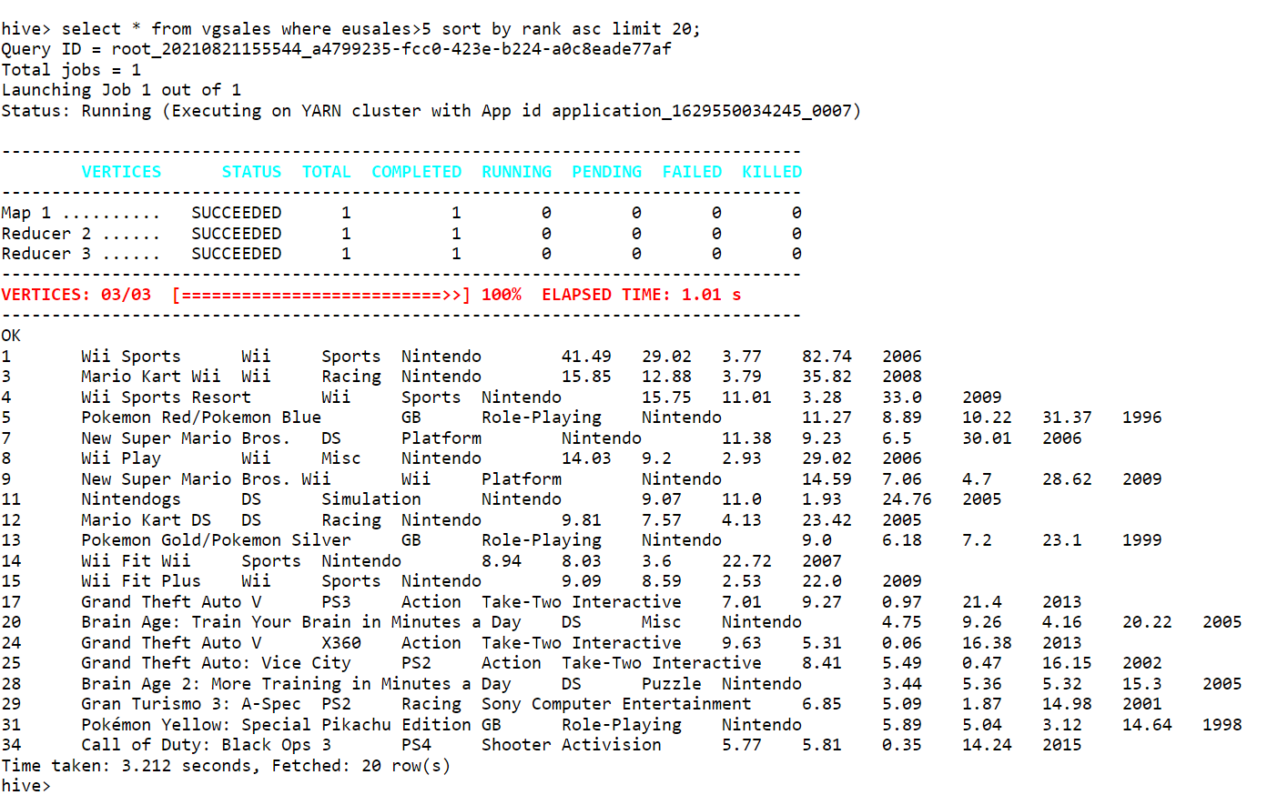
Query for obtaining Top 20 Video Game details whose Europe Sales are above 5 scale and arranged in incremental order of rank

Slide 6
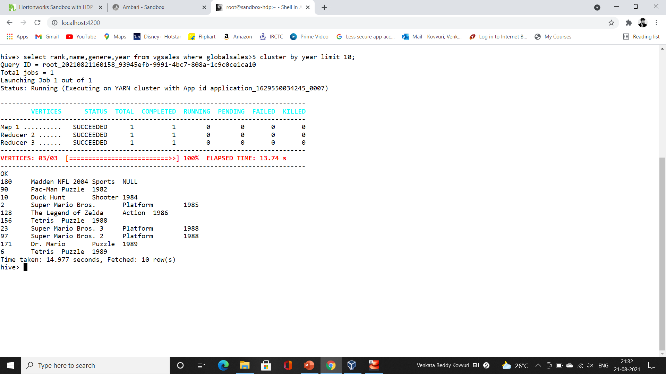
Query for obtaining the Video Game and its genere , rank whose sales around the world are above 5 scale and clustered by their release year

Slide 7
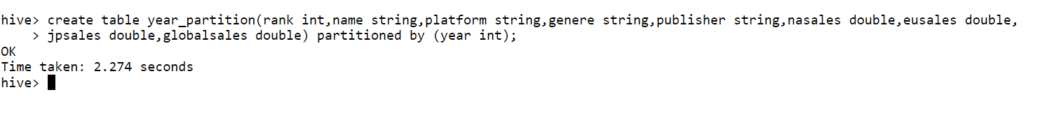
Query for creating a Partition table with partitioning by year of Video game release

Slide 8
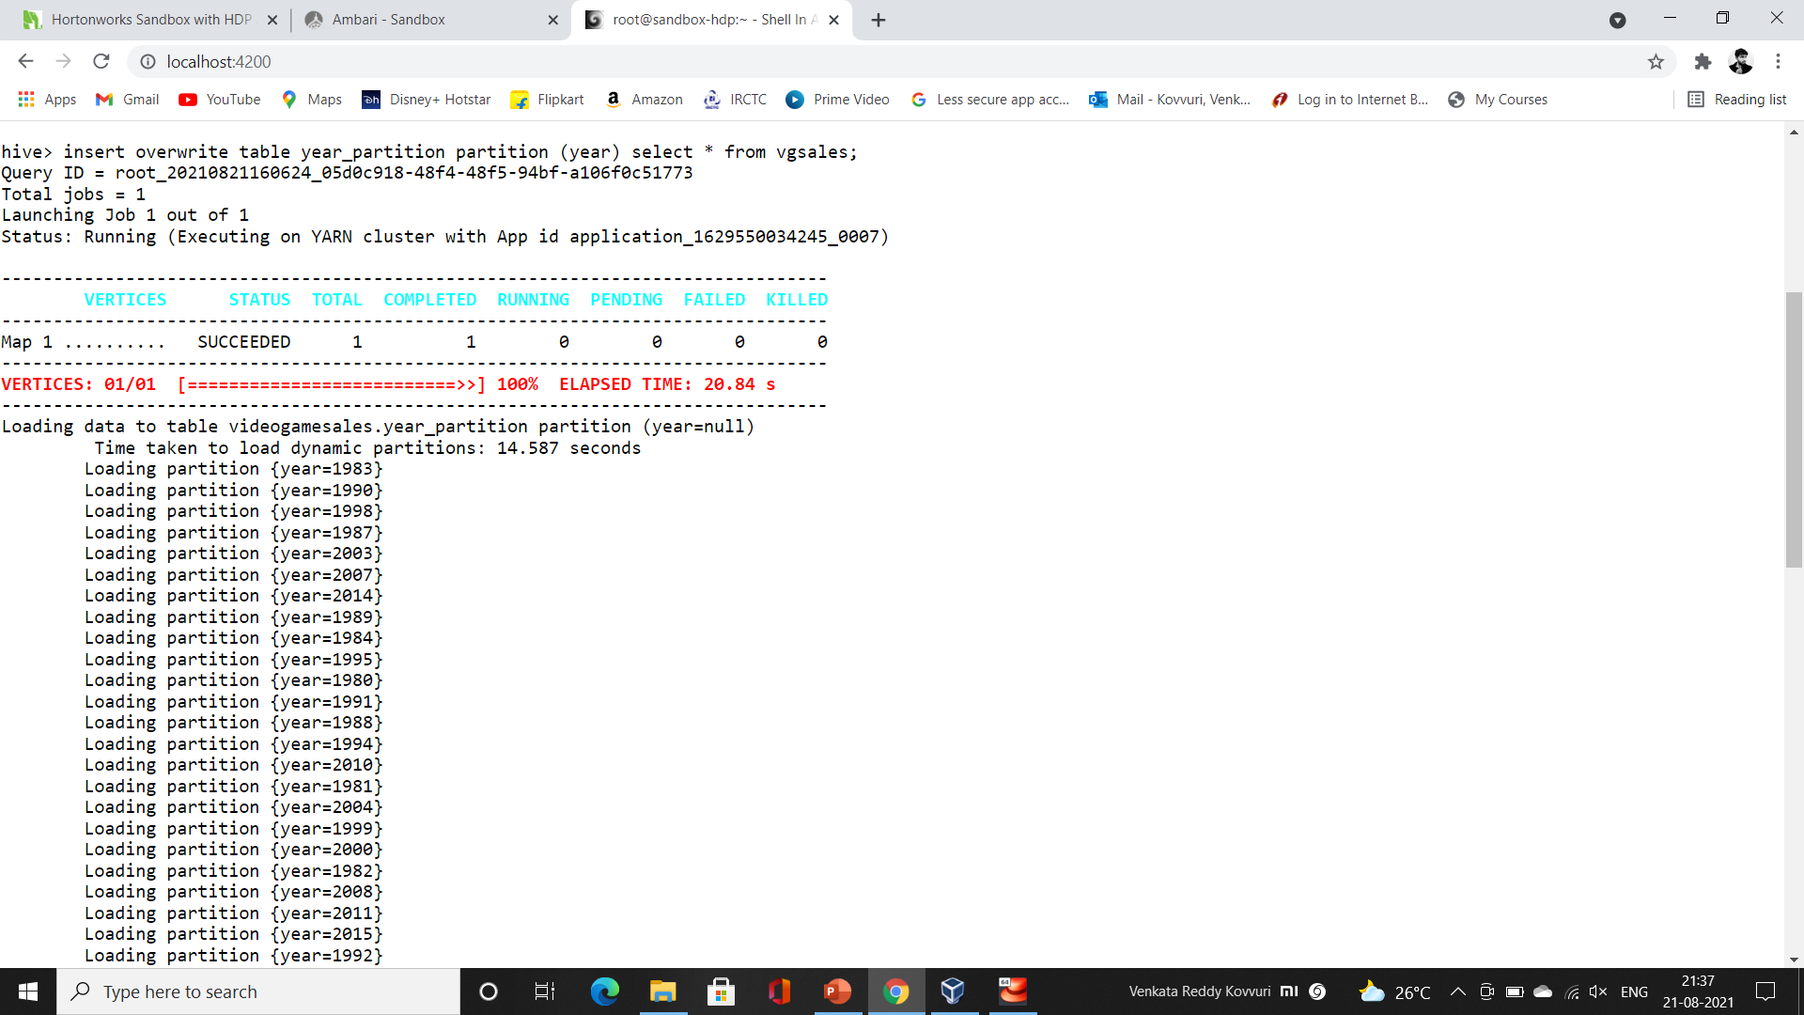
Query for overwriting the Partitioned Table with hive table

Slide 9
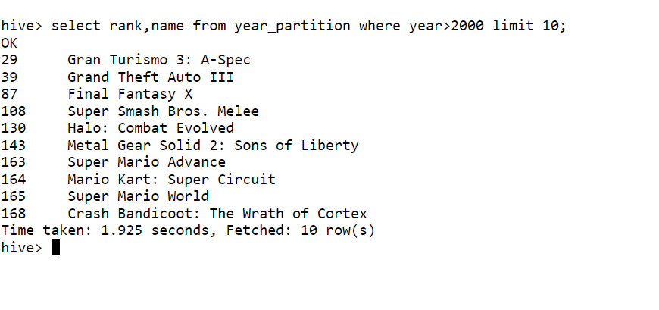
Query for obtaining the top 10 Videogames name and year from partitioned table which released after 2000

Slide 10
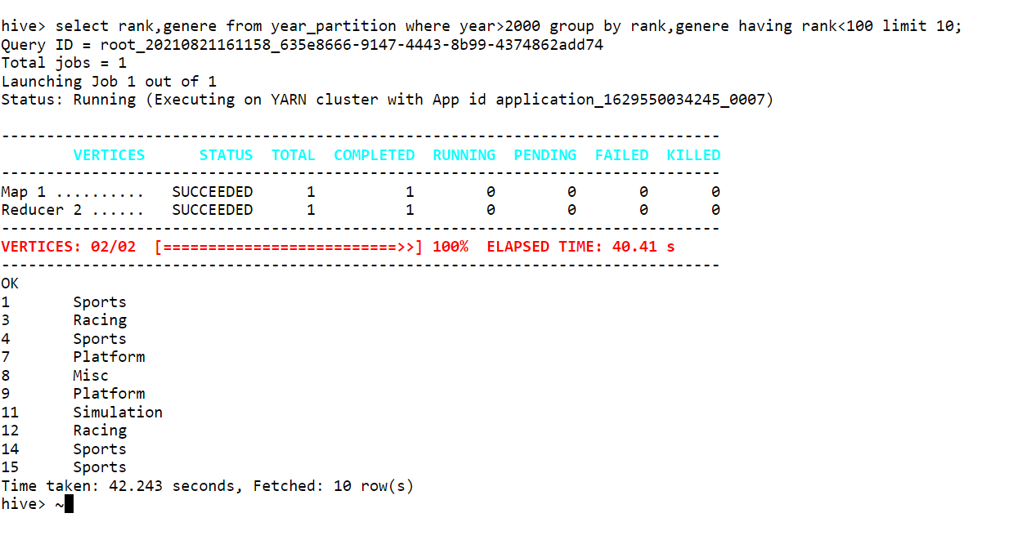
Query for obtaining the top 10 Videogame generes with their ranks which are released after 2000 and having rank below 100

Slide 11

Query for creating Bucketing table and clustering 5 buckets

Slide 12
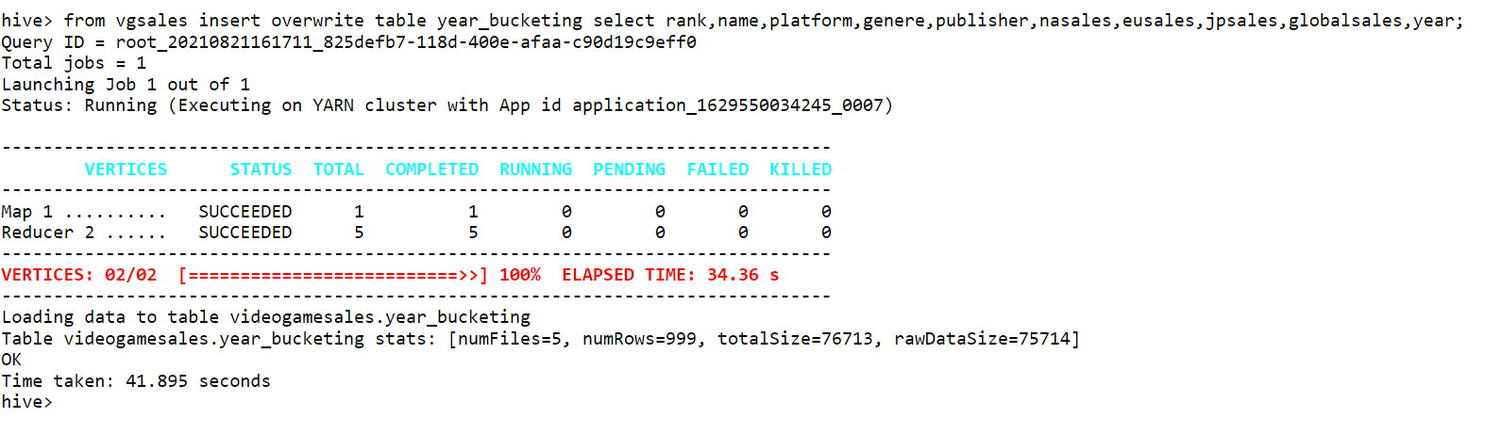
Query for overwriting the data into bucketed table from hive table

Slide 13
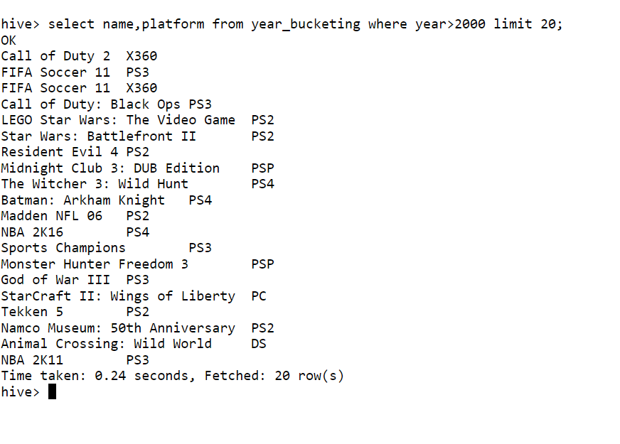
Query for obtaining 20 Videogame name and its platform from bucketed table which are released after 2000

Slide 14
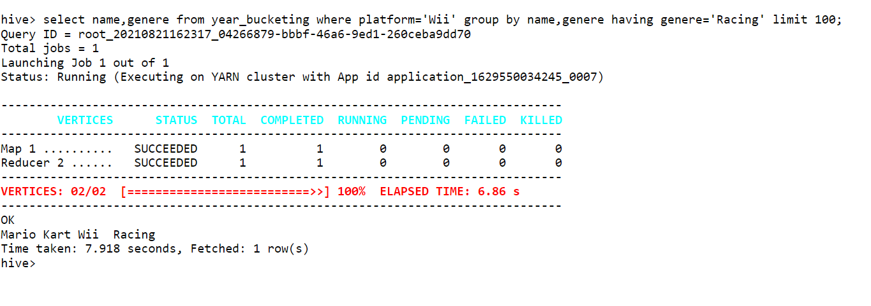
Query for obtaining Video game name of Racing genere which runs on Wii platform

Slide 15
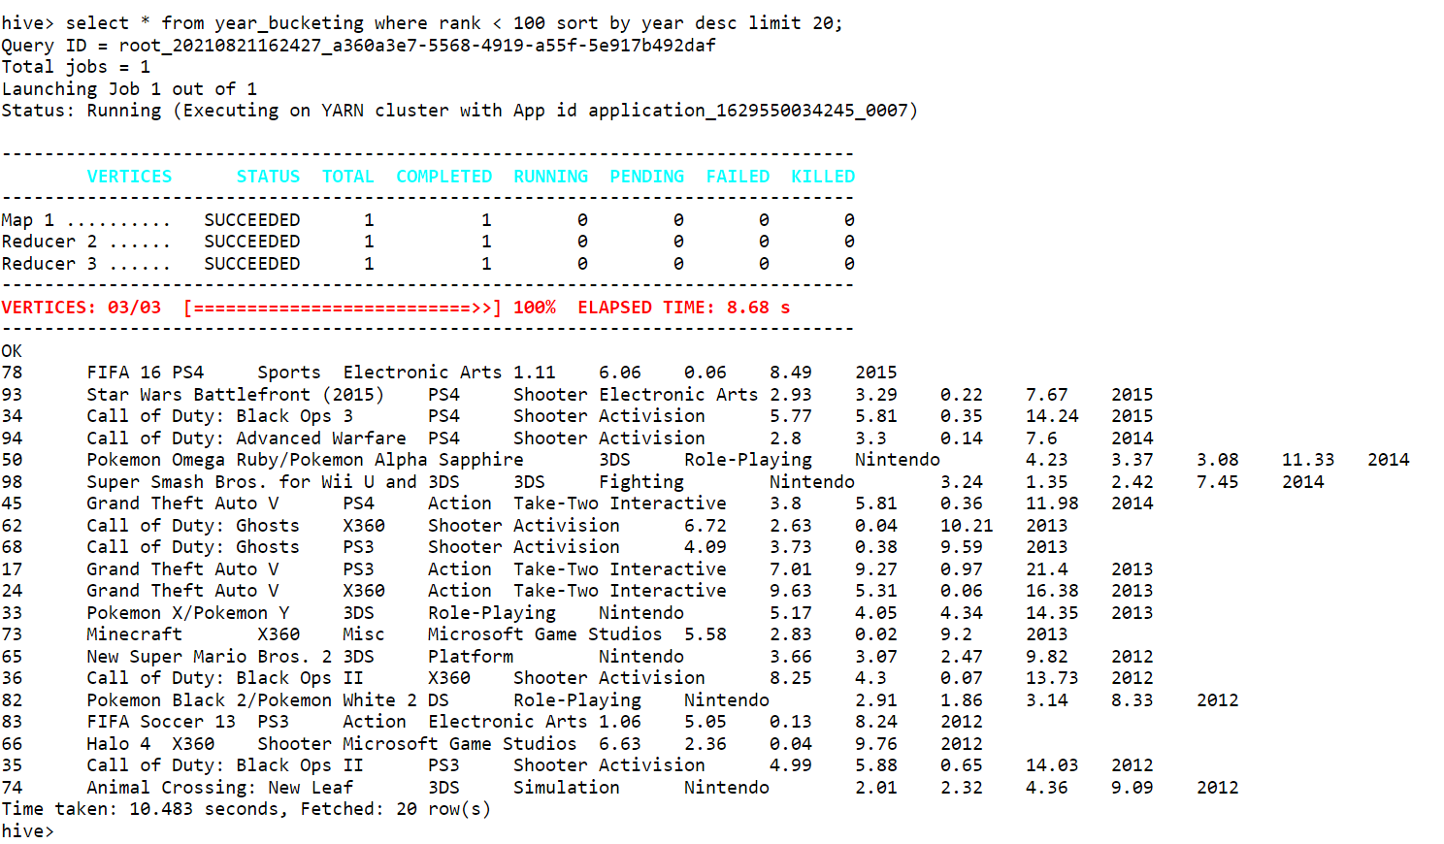
Query for obtaining details of Video game which are in top 100 and show in order of latest release

